Slide 1
Introduction to Statistics
By: Muhammad Afif Hendrawan, S.Kom., M.T.
Translated by: Septian Enggar S

Slide 2
Preliminary
Quiz | 30 | %
Assignment | 20 | %
Mid-Exam | 20 | %
Final-Exam | 30 | %
Only email and Discord are allowed to make a contact with lectu

Slide 3
Think about this
DEDUCTION
INDUCTION
SCIENTIFIC METHOD
A doctor conducts a medical diagnosis based on patient data, research activities from journals, case study notes.
Neurologist examines brain wave signal from several subjects then tries to resume a generalbrain activity phenomenon.
Doing several scientific stages to prove the hypothese of a phenomenon by inferencing the induction.

Slide 4




Metode Ilmiah
OBSERVATION
DEFINING
HYPOTHESE
SCIENTIFIC METHOD
HYPOTHESE
TESTING
EXPERIMENT

Slide 5

An Example of Scientific Method
A research activity is performed to 20 patients with certain disease. To provide a reliable conclusion based on the data, the researcher has several questions:
If another 20 patients is added, will the result be the same with the previous activity?
If another lab analyzes same blood sample, will the result be the same?
If the blood samples is kept on the different temperature, will the result be the same?

Slide 6
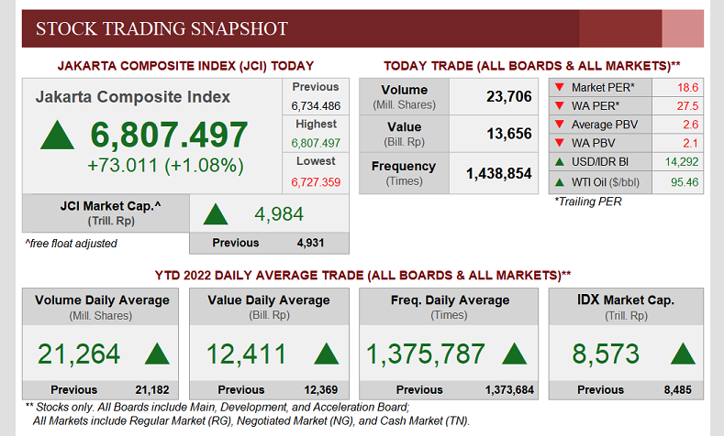
Advantages

Slide 7
So, what is statistics?

Slide 8
What is statistics?
Statistical
An assumpation that is produced by unknown numerical quantity, such: mean, median, or mode (Sumarjaya, 2016)
A field of knowledge which is related to information collecting, organizing, analysis, interpretation, and presentation which can be represented by numeric form. (Sumarjaya, 2016)
Statistics are procedures that combine, organize, and summarize data to make inferences (Burnham, 2015)
Statistics

Slide 9
When, Where, and Why
When we use statistics?
When we need to find the answer of a phenomenon which needs data resume.
Where do we find or implement statistics?
For almost aspects of life, such: business, research, government, military, sport
Why do we need statistics?
Research → To understand a phenomenon based on data discovery
Explaining the phenomenon → It is used to explain a phenomenon understandable and more concise (upper level explanation)

Slide 10


Statistics Type
Descriptif
To consolidate the data become a single value to represent all data
Statistics
Inferensial
To analyze a relationship between observed variables of a phenomenon
To make an inferensial and assumption to collected data to produce a summary of phenomenon

Slide 11


Tools

Slide 12


